Slide 1
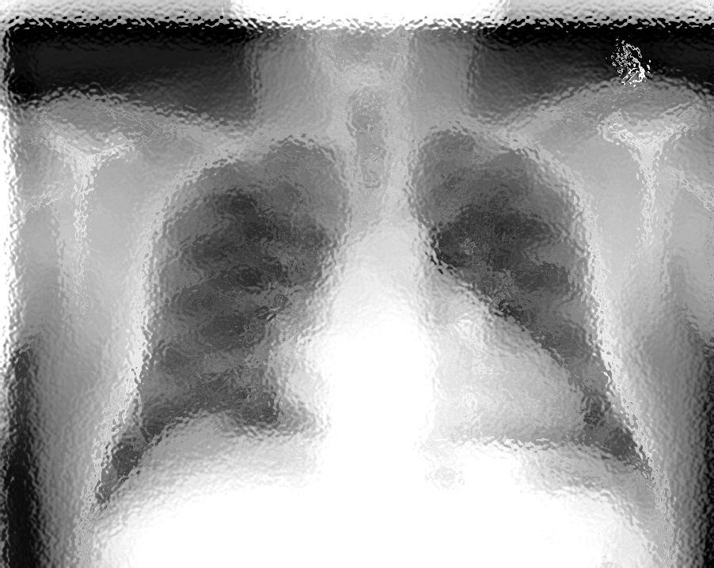
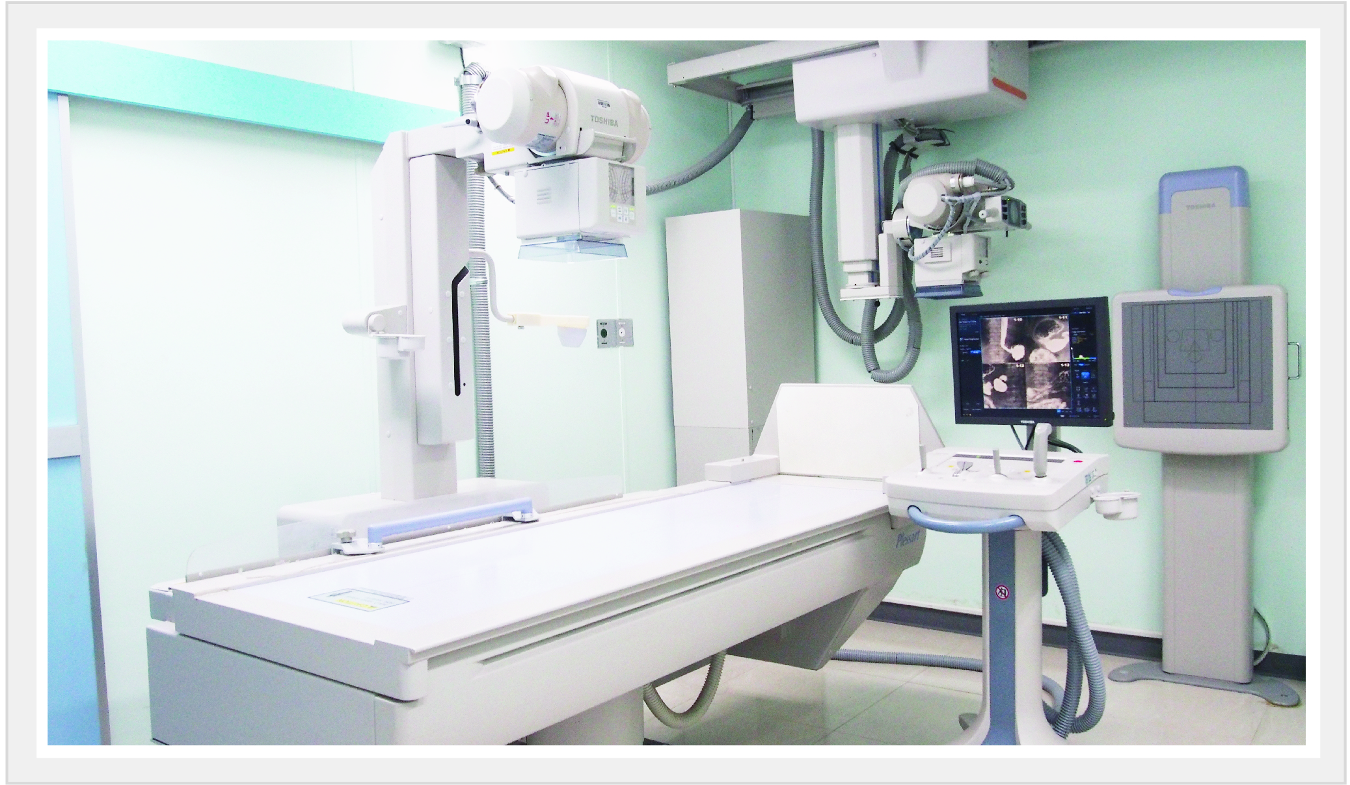
Detection of Pulmonary Tuberculosis based on
Convolutional Neural Networks
Krit Sriporn^{1,2}, Cheng-Fa Tsai²
¹Department of Tropical Agriculture and International Cooperation, National Pingtung University of Science and Technology Pingtung, Taiwan
²Department of Management Information Systems, National Pingtung University of Science and Technology Pingtung, Taiwan
1-3 June 2019, South Korea
Notes:
This research explores the efficiency of data classification technique in the combination of the feature selection methods and the Wrapper method for predicting tourists’ behavior of virtual museum in Chaiya National Museum. Significantly

Slide 2
Outline
Introduction
Literature review
Methodology
Result
Conclusions
Acknowledgements
References

Slide 3
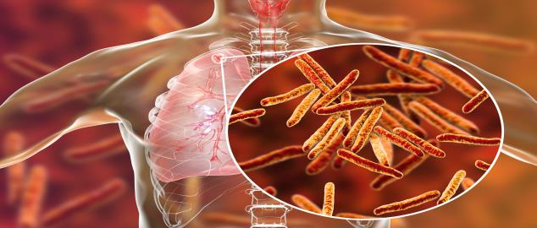
1. Introduction
Tuberculosis (TB) is caused by bacteria (Mycobacterium tuberculosis) that most often affect the lungs. Tuberculosis is curable and preventable.
TB is spread from person to person through the air. When people with lung TB cough, sneeze or spit, they propel the TB germs into the air.
Figure 1. Tuberculosis (TB)

Slide 4
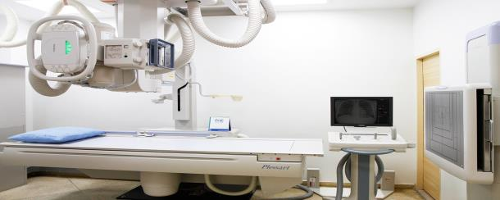
1. Introduction
Radiology (X-rays) is used in the diagnosis of tuberculosis. Abnormalities on chest radiographs may be suggestive of, but are never diagnostic of, TB but can be used to rule out pulmonary TB.
A posterior-anterior (PA) chest X-ray is the standard view used; other views (lateral or lordotic) or CT scans may be necessary.
Figure 2. Radiology (X-rays) .

Slide 5
1. Introduction
(1) To investigate the efficiency of CNN techniques for detecting the lesions indicative of PTB infection from digital x-ray images.
(2) To compare the performance of CNN techniques utilizing VGG-13, Resnet-34 and Alexnet to increase the effectiveness of detection for lesions indicative of PTB infection.
1.1 Research Objectives

Slide 6
2. Literature review
Figure 3. medical stomach images .
Research name | Objective | Journal
Medical image retrieval using deep convolutional neural network. | To to retrieve multimodal medical images for different body organs. | Neurocomputing (Qayyum et al., 2017)

Slide 7
2. Literature review
Figure 6. disease classification detection.
Research name | Objective | Journal
Deep Learning in Radiology. | To describe several areas within radiology in which deep learning techniques are having the most significant impact: lesion or disease detection, classification, quantification, and segmentation. | Academic Radiology(McBee et al., 2018)

Slide 8
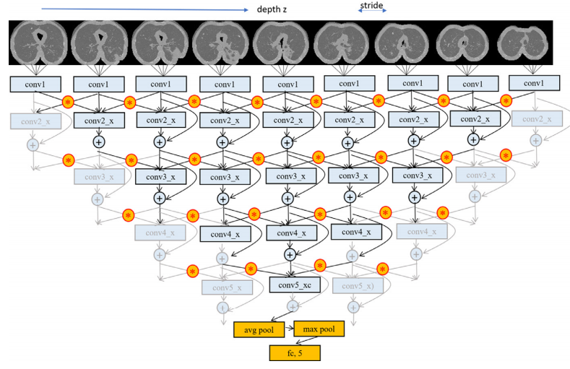
2. Literature review
Figure 4. CT pulmonary images based on residual deep learning.
Research name | Objective | Journal
Analysis of tuberculosis severity levels from CT pulmonary images based on residual deep learning. | To contend with smaller datasets (i.e. in hundreds) and the characteristics of CT TB images | Neurocomputing(Gao et al., 2019)

Slide 9
3. Methodology
The methods of this research are divided into 3 parts as shown in the Figure 5.
(1) The first part is the data collection methods.
(2) The second part is the image processing methods, which are the dataset preparation step.
(3) The third part is the data analysis methods, which is processed to create a model in order to predict the solution and select the most accurate method.

Slide 10
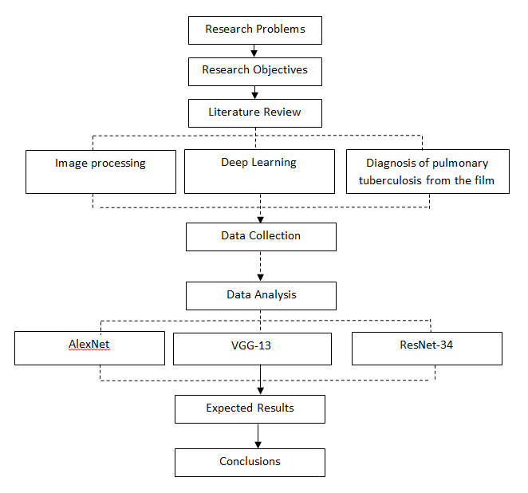
Figure 5. Conceptual Framework.

Slide 11
3. Methodology
The first part is the data collection methods.
Dataset
This research uses random sampling of digital x-ray images for experimentation with 4,400 images from 20,000 images. All images were rotated as developed by Python with Open CV framework and transform RGB image into Grey Scale to reduce the image size by training image 80% and testing images 20% from overall images.
Figure 10. digital x-ray images Data collection

Slide 12
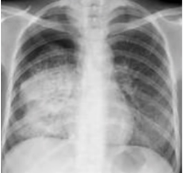
3. Methodology
This category comprises all findings typically associated with active pulmonary TB
Dense homogenous opacity in right, middle and lower lobe of primary pulmonary tuberculosis.
Figure 12. Dense homogenous opacity .

Slide 13
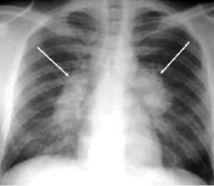
3. Methodology
This category comprises all findings typically associated with active pulmonary TB
Chest x-ray showing bilateral hilar adenopathy of primary pulmonary tuberculosis.
Figure 13. bilateral hilar adenopathy

Slide 14
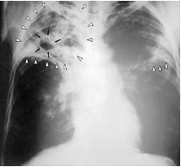
3. Methodology
This category comprises all findings typically associated with active pulmonary TB
Chest X-ray of a person with advanced tuberculosis: Infection in both lungs is marked by white arrow-heads, and the formation of a cavity is marked by black arrows.
Figure 14. Infection lungs

Slide 15
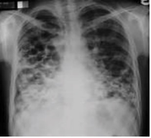
3. Methodology
This category comprises all findings typically associated with active pulmonary TB
Chest x-ray showing course bronchiectasis of the lungs post-primary pulmonary tuberculosis.
Figure 16. bronchiectasis

Slide 16
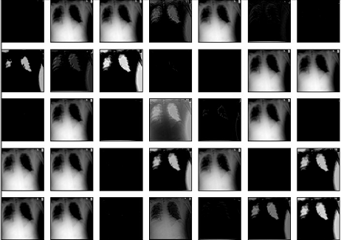
3. Methodology
The second part is the image processing methods
All images were rotated as developed by Python with Open CV framework and transform RGB image into Grey Scale to reduce the image size by training image 80% and testing images 20% from overall images, as show in Figure 17.
Figure 17. the image processing

Slide 17
3. Methodology
The Third part is the Data Analysis methods
Convolutional Neural Network (CNN) is a form of deep learning consisting of a wide range of structures that connect to each other. Nowadays, image classification with CNN solution is a technique that provides superior effectiveness, as show in Figure 18.
AlexNet
VGG-13
ResNet-34

Slide 18
3. Methodology
This architecture is composed of 5 convolutional layers followed by 3 fully connected layers, as depicted in Figure 18.
Figure 18. AlexNet structure
Notes:
These features are intended to improve the efficiency of predictive modeling and to provide predictive features that can be quickly processed, as show in Figure.

Slide 19
3. Methodology
(a) Standard Neural Net
(b) After applying dropout
Another problem that this architecture solved was reducing the over-fitting by using a Dropout layer after every FC layer.
Figure 19. Dropout Technique
Notes:
These features are intended to improve the efficiency of predictive modeling and to provide predictive features that can be quickly processed, as show in Figure.

Slide 20
3. Methodology
VGG is a simpler architecture model, since its not using much hyper parameters.
Figure 20. VGG-13 structure
Notes:
These features are intended to improve the efficiency of predictive modeling and to provide predictive features that can be quickly processed, as show in Figure.

Slide 21
3. Methodology
ResNets are easy to optimize, but the “plain” networks (that simply stack layers) shows higher training error when the depth increases.
Figure 21. Resnet structure
Notes:
These features are intended to improve the efficiency of predictive modeling and to provide predictive features that can be quickly processed, as show in Figure.

Slide 22
3. Methodology
F (X)
F (X) + X
Shortcut connections are those skipping one or more layers shown in Figure 22.
Figure 22. Shortcut connections of Resnet structure
Notes:
These features are intended to improve the efficiency of predictive modeling and to provide predictive features that can be quickly processed, as show in Figure.

Slide 23
4. Result
The most effectiveness was found by CNN in this experiment. Consequently, the highest accuracy rate of 98% was found using Resnet-34, followed by the second highest accuracy rate of 97% for VGG-13 and the third rated accuracy rate of 95% for Alexnet. The highest speed was shown by Alexnet, while second was VGG-13 and third was Resnet-34., as show in Table 1.

Slide 24
4. Result
Table 1.Confusion Matrix
Structure | Accuracy % | Precision% | Recall% | F1 score% | Average%
Alexnet | 95 | 95 | 94 | 95 | 95
VGG-13 | 97 | 97 | 98 | 97 | 97
Resnet-34 | 98 | 99 | 97 | 98 | 98
Notes:
1 ได้พิพิธภัณฑ์เสมือนต้นแบบของการสร้างพิพิธภัณฑ์เสมือนกับพิพิธภัณฑ์หรือสถานที่อื่นๆ
2สามารถสร้างmodel ที่ใช้ในการทำนายพฤติกรรมของนักท่องเที่ยว เพื่อใช้ในการส่งเสริมการท่องเที่ยวพิพิธภัณฑ์แห่งชาติไชยาที่สามารถตอบสนองความต้องการของนักท่องเที่ยว
3.เพื่อให้รู้ถึงคุณลักษณะของพิพิธภัณฑ์เสมือนที่มีความสัมพันธ์กันจากพฤติกรรมของนักท่องเที่ยว

Slide 25
5. Conclusion
From the experimental results in this research, it was found that Resnet-34 exhibited the most effectiveness in terms of CNN structure because it was able to train and remember repeat images from the training data better than VGG-13 and Alexnet. Despite the Resnet-34 validation accuracy, it was considerably more consistent than VGG-13 and Alexnet.
Notes:
This research explores the efficiency of data classification technique in the combination of the feature selection methods and the Wrapper method for predicting tourists’ behavior of virtual museum in Chaiya National Museum.

Slide 26
6. Acknowledgements
Suratthani Rajabhat University
National Pingtung University -
of Science and Technology
Ministry of Science and Technology
of Taiwan
All Attendees

Slide 27
7. References
Andujar, C., A. Chica and P. Brunet. 2013. User-interface design for the Ripoll Monastery exhibition at the National Art Museum of Catalonia. Computers & Graphics, 36 : 28–37
Chen T-C, Ku K-C, Ying T-C (2012) A process-based collaborative model of marine tourism service system -The case of Green Island area, Taiwan. Ocean & Coast Manag 64: 37-46
Gavalas D, Konstantopoulos C, Mastakas K, Pantziou G (2013) Mobile recommender systems in tourism. J Netw & Comp Appli 39: 319-333
Liu, H. and L. Yu. 2005. Toward Integrating Feature Selection Algorithms for Classification and Clustering. Journal IEEE Transactions on Knowledge and Data Engineering, 17: 491-502
Martella, C., A. Miraglia, J. Frost, M. Cattani, M. Steen. 2016. Visualizing, clustering, and predicting the behavior of museum visitors. Pervasive and Mobile Computing, 38: 430-443
Martins J, Gonçalves R, Branco F, Barbosa L, Bessa M (2017) Three-Dimensional Interactive Virtualization of University Buildings: A Port wine tourism application proposal. J Dest Mar & Manag 6: 103–109
Michael S., Z. A. Leong, F. Block, J. Diamond, E. M. Evans 2017 An Interactive Tabletop Game for Natural History Museums. Computers & Education 58: 59-78

Slide 29
3. Methodology
The Third part is the Data Analysis methods
The precision is the ratio tp / (tp + fp) where tp is the number of true positives and fp the number of false positives. The precision is intuitively the ability of the classifier not to label as positive a sample that is negative

Slide 30
3. Methodology
The Third part is the Data Analysis methods
The recall is the ratio tp / (tp + fn) where tp is the number of true positives and fn the number of false negatives. The recall is intuitively the ability of the classifier to find all the positive samples.

Slide 31
3. Methodology
The Third part is the Data Analysis methods
The F1 score can be interpreted as a weighted harmonic mean of the precision and recall, where an F-beta score reaches its best value at 1 and worst score at 0.
The support is the number of occurrences of each class in y_true
Support 439 441 880 3520 880

